Slide 1
COA Lab Project (2016-17) The LNMIIT, Jaipur
SMART JACKET
Himanshi Swaroop (15ucs052)
Harshali Jain (15ucs047)
Sonal Jain (15ucs054)

Slide 2

Introduction
Protects smartphone users from losing their phones
Anxiety about keeping your phone charged all the time.
Inconvenience of having to take out your phone from pockets or bags to change songs.
Helps reduce stress(in the form sleep shade)
Location tracker inbuilt
Inconvenience of having to take out your phone from pockets or bags to call someone
Thermoregulation
Distractions from important matters due to constant messages and calls
So here is the solution for all above problems that is
SMART JACKET!!

Slide 3
Functions
1.Password: Jacket can be used only when password is correct. The password given by the user is passed as a integer(0-7) which is verified by the function.
Pass R00
2.Music:Song is taken from register. This function searches for passed song and plays it if found. Contains mnemonic MOV which moves favourite song no. to register(MOV register,integer ).
Music R00
3.Charge:It is responsible for charging the phone.If battery is below 40%,it starts charging the phone and switch on the LED light.
Charge R01
4.Sleep Shade: When the corresponding button is pressed then the shades slides down.
Sleepshade
5.Connect Call: To whom we have to call is passed as into register and if this name is available in the contact list it calls the person.
Connect R01

Slide 4
6.Loss Prevention: It alerts when the phone is lost and finds it if it is available in any direction in a particular range
Loss
7.Notification: It notifies for call or sms on mobile.
Notify R01 (bit tells whether it is sms or a call)
8.Distance-Time Finder: It gives the distance and time taken between source and destination
Distancetime R01,R02
9.Thermoregulation: It regulates the temperature according to the users requirement(hot or cold)
Temp R00 (bit 0:hot and 1:cold)
10. JMP : It compares the result of previous instruction with 0 and jumps to a particular label.
JMP R01, Label

Slide 5
Memory Model
Aligned Memory Model
RAM Sizes-
Storing Instruction- 12x8
Storing Data- 8x8
Little Endian
Byte Addressable

Slide 6
Registers
General Purpose Registers– 4
R00 – R03
Special Purpose Registers –
Program Counter, Instruction Register, Zero Flag, Negative Flag

Slide 7
Instruction Format
2 Address Instructions –
1 Address Instructions –
0 Address Instructions –
OPCODE | OPERAND 1 | OPERAND 2
2 bits 3 bits 3 bits
OPCODE | OPERAND 1
5 bits 3 bits
OPCODE
8 bits

Slide 8
Instruction Design
Two Addressable
Distancetime- 00 xxx yyy
Mov- 01 xxx yyy
JMP – 10 xxx yyy
(Escape Code – 11)
One Addressable
Charge- 11 000 xxx
Music- 11 001 xxx
Temp- 11 010 xxx
Connect- 11 011 xxx
Pass- 11 100 xxx
Notify- 11 101 xxx
Decrement- 11 110 xxx
(Escape Code – 111)

Slide 9
Continued…
Zero Addressable
Sleepshade- 11 111 000
Loss- 11 111 001
HALT- 11 111 010

Slide 10
Instruction Types
Data Transfer - MOV
Dyadic Operations -Distancetime
Monodic Operations - Charge, Music, Temp, Callconnect, Decrement, Pass, Notify
Procedure Call/Compare Functions -JMP, Pass
Arithmetic - Temp, Charge, Distancetime

Slide 11
Data Types
Numeric –
Integer

Slide 12
Addressing Modes
Direct Mode
Immediate Mode

Slide 13
Flow of Control Handling
JMP : It compares the result of previous instruction with the provided value and jumps to a particular label.
JMP <Register>,<Label>
HALT: Halts the procedure containing it.
HALT

Slide 14
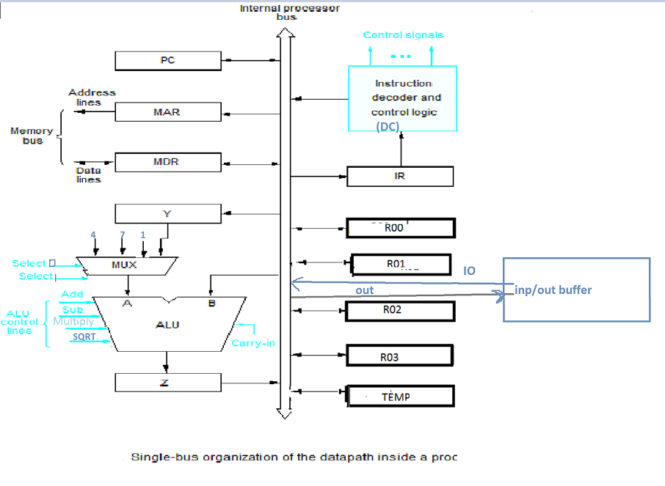
DATA PATH-SINGLE BUS ARCHITECTURE
Multiplexer
Select lines | Select 0 | Select 1
Select 4 | 0 | 0
Select 7 | 0 | 1
Select 1 | 1 | 0
Select Y | 1 | 1

Slide 15
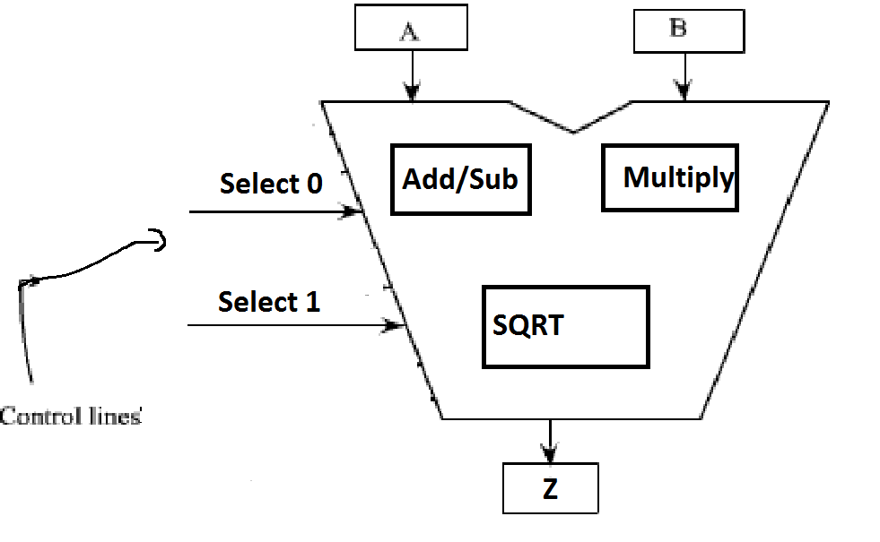
ALU DESIGN
ALU control Signals
Operation | S0 | S1
Add | 0 | 0
Subtract | 0 | 1
Multiply | 1 | 0
Sqrt | 1 | 1

Slide 16
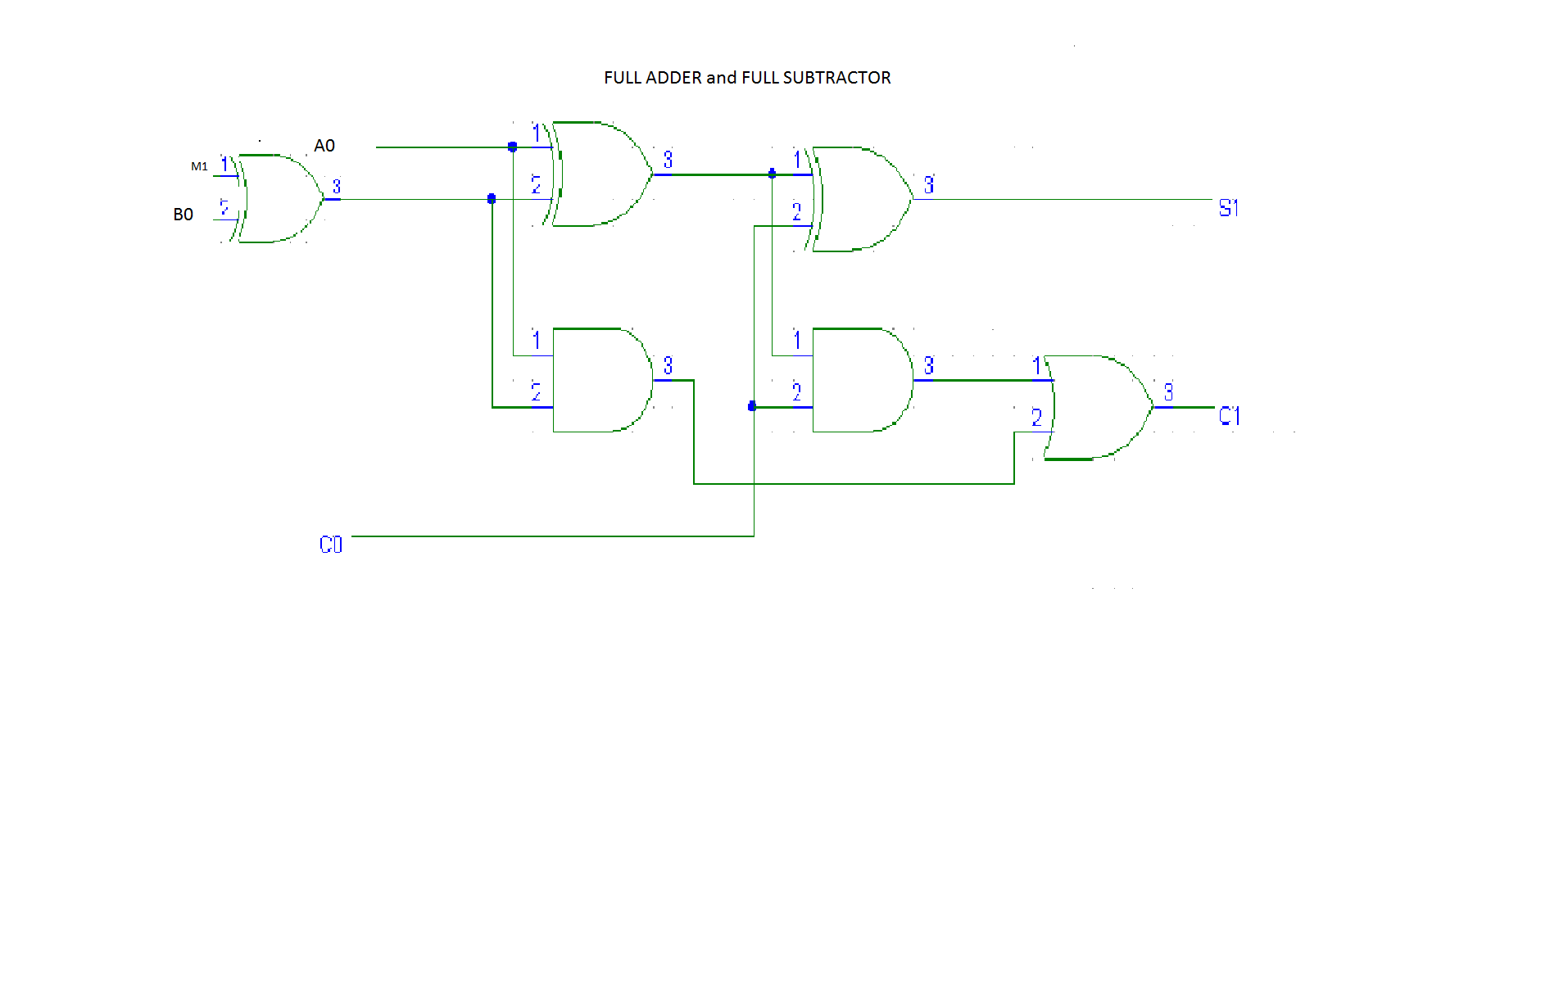
FULL ADDER/SUBTRACTOR

Slide 17
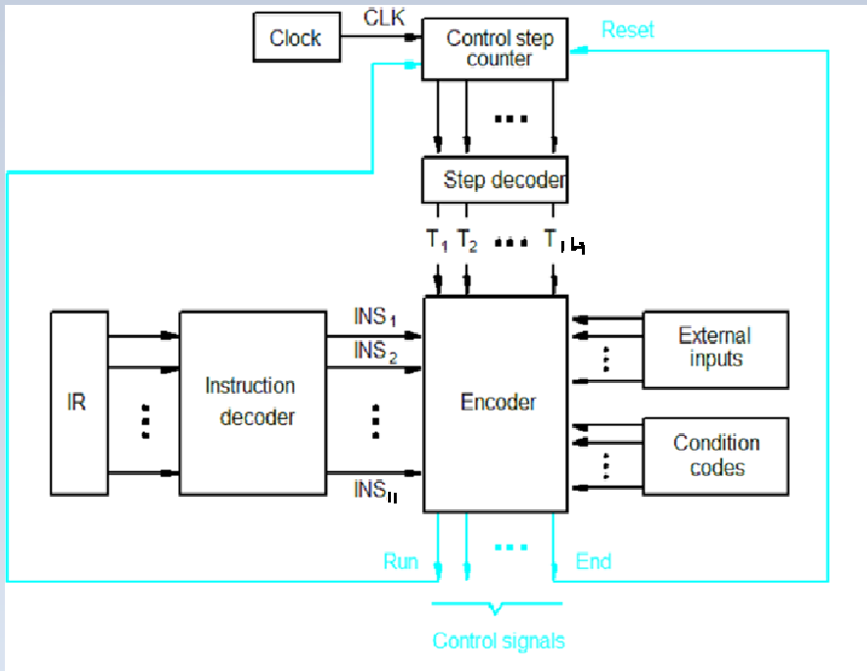
HARDWIRED CONTROL UNIT

Slide 18
Micro-Instructions
DEC R02
1-Pcout,MARin,READ,SELECT4,ADD,Zin
2-Zout,PCin,Yin,WMFC
3-MDRout,IRin
4-R02out,SELECT1,sub,Zin
5-Zout,R02in
6-END
JMP R02 LABEL1
1-Pcout,MARin,READ,SELECT4,ADD,Zin
2-Zout,PCin,Yin,WMFC
3-MDRout,IRin
4-Offset-field-ofIRout,SELECTY,ADD,Zin,If ZF=1 then End
5-Zout,Pcin,END
PASS R00
1-Pcout,MARin,READ,SELECT4,ADD,Zin
2-Zout,PCin,Yin,WMFC
3-MDRout,IRin
4-R00out,Select4,sub,Zin
5-if ZF=1 then OUT
6-end
MOV R02 2
1-Pcout,MARin,READ,SELECT4,ADD,Zin
2-Zout,PCin,Yin,WMFC
3-MDRout,IRin
4-DCout,R02in
5-END

Slide 19
DIS R01,R02
1-Pcout,MARin,READ,SELECT4,ADD,Zin
2-Zout,PCin,Yin,WMFC
3-MDRout,IRin
4-R01out,Yin
5-SELECTY,MUL,Zin
6-Zout,R01in
7-R02out,Yin
8-SELECTY,MUL,Zin
9-Zout,R02in
10-R01out,Yin
11-R02out,SELECTY,add,Zin
12-Zout,SQRT,Zin
13-Zout,R01in
14-END
CRGE R00
1-Pcout,MARin,READ,SELECT4,ADD,Zin
2-Zout,PCin,Yin,WMFC
3-MDRout,IRin
4-R00out,SELECT4,sub,Zin
5-if NF=1 then OUT
6-END
MUSI R01
1-Pcout,MARin,READ,SELECT4,ADD,Zin
2-Zout,PCin,Yin,WMFC
3-MDRout,IRin
4-R01out,SELECT7,sub,Zin
5-if NF=1 then OUT
6-END
CONN R02
1-Pcout,MARin,READ,SELECT4,ADD,Zin
2-Zout,PCin,Yin,WMFC
3-MDRout,IRin
4-R02out,SELECT7,sub,Zin
5-if NF=1 then OUT
6-END
NOTIFY R00
1-Pcout,MARin,READ,SELECT4,ADD,Zin
2-Zout,PCin,Yin,WMFC
3-MDRout,IRin
4-R00out,Zin,if ZF=1 then OUT
5-END

Slide 20
TEMP R01
1-Pcout,MARin,READ,SELECT4,ADD,Zin
2-Zout,PCin,Yin,WMFC
3-MDRout,IRin
4-IOout,SELECT4
5-if ZF=1 then sub,Zin else add,Zin
6-END
HALT
1-Pcout,MARin,READ,SELECT4,ADD,Zin
2-Zout,PCin,Yin,WMFC
3-MDRout,IRin
4-HLT

Slide 21
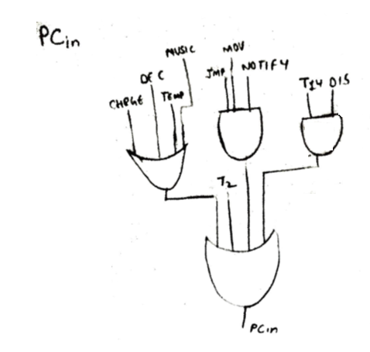
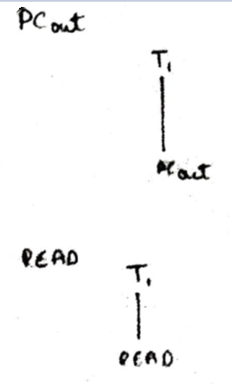
HARDWIRED CONTROL SIGNALS
There are 30 control signals:
Pcin, Pcout, Read, MARin, Select Y,WMFC, MARin,DCout,IRin,IOout,SelectY,Select7,Select1,Mult,Yin,R00in,R00out,R01in, R01out,R02in,END,Zin,ADD,SQRT,HALT,R02out,Zout,SUB,OUT.
1.
2.
3.

Slide 22
4.
5.

Slide 23
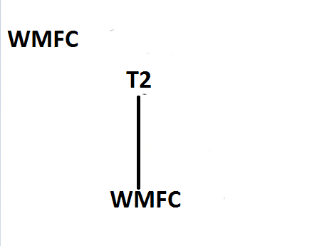
7.

Slide 24
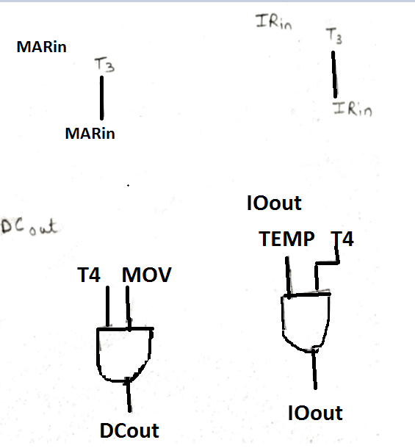
9.
9.
8.
11.
11.
10.

Slide 25
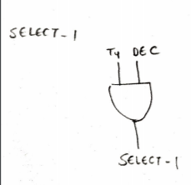
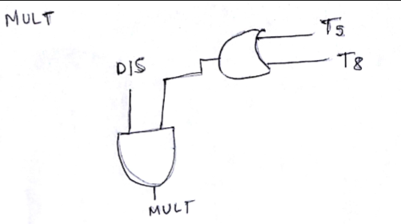
12.
13.
15.
14.

Slide 26
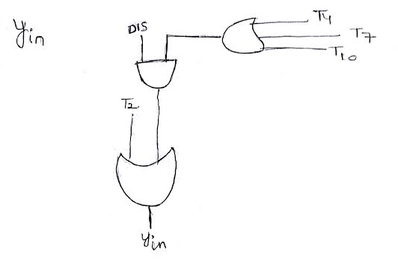
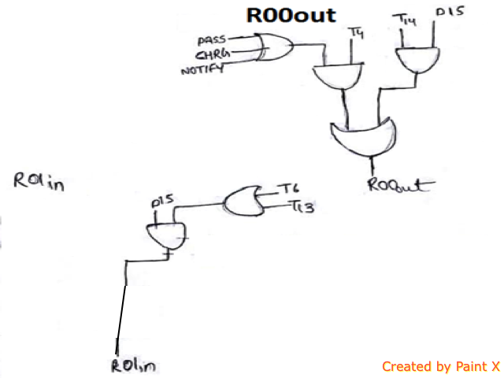
16.Yin
18.
17.
19.

Slide 27
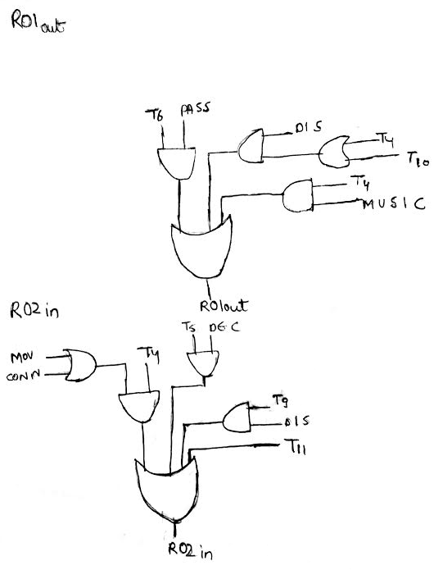
20.
21.

Slide 28
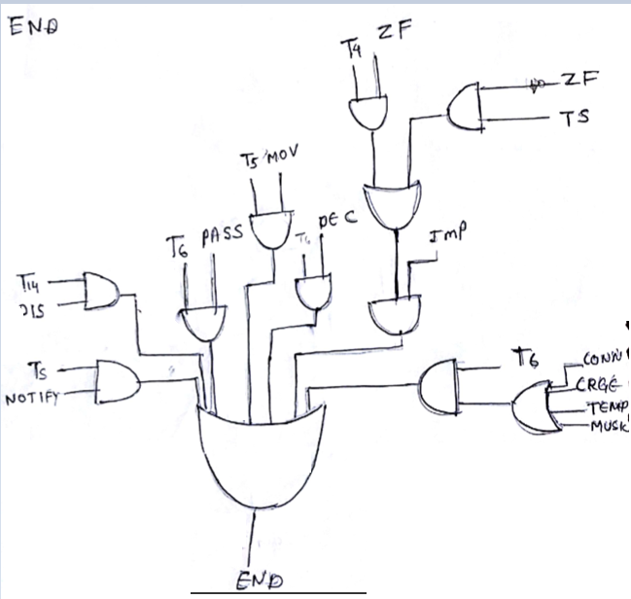
22.

Slide 29
23.

Slide 30
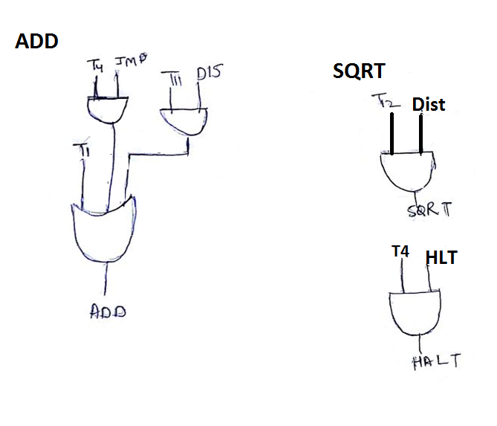
24.
25.
26.
HALT

Slide 31
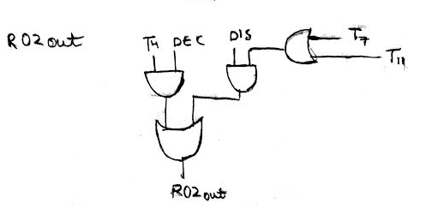
27.

Slide 32
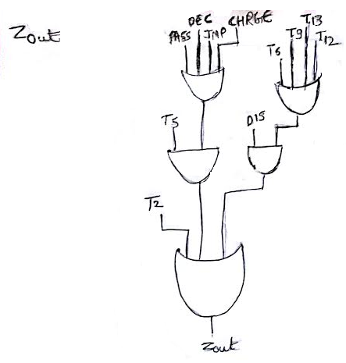
28.

Slide 33
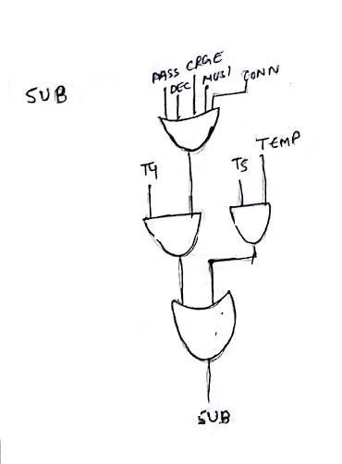
29.

Slide 34
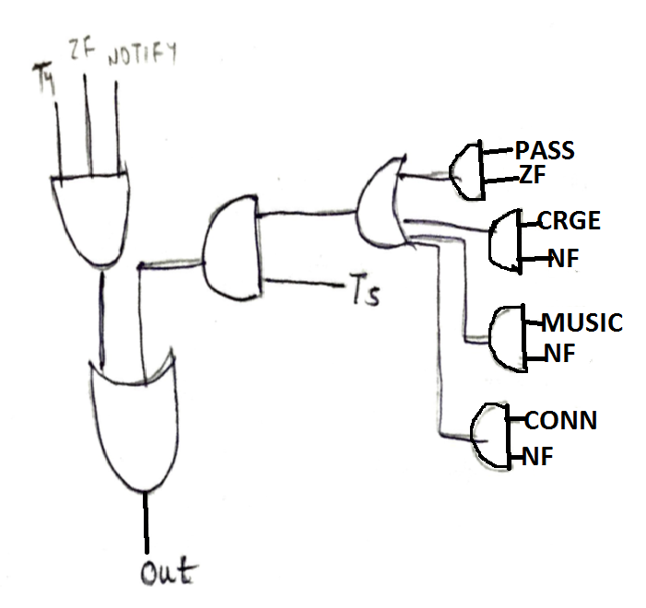
30.
OUT

Slide 35
Thank You
THE END

